Slide 1
Writing your first grant application
Ettie Unwin
8th June 2026

Slide 2
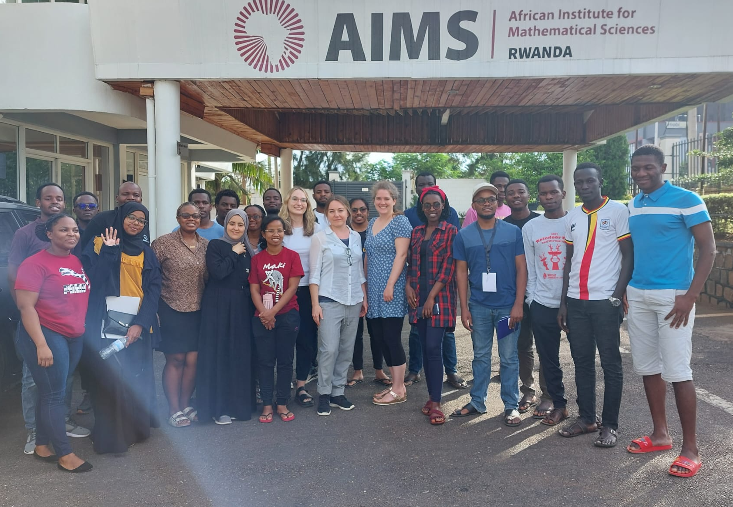
A little bit about me
PhD in Engineering at the University of Cambridge looking at quantifying uncertainty.
Postdoc and fellowship at Imperial College London developing novel methods for outbreak response.
Member of ICL Ebola and COVID-19 response team
Senior Lecturer in Statistics at University of Bristol
Passionate about capacity building!

Slide 3
Sorry in advance that it’s a bit UK specific…. There might be other funders e.g. in USA that you might be eligible for that I don’t know

Slide 4
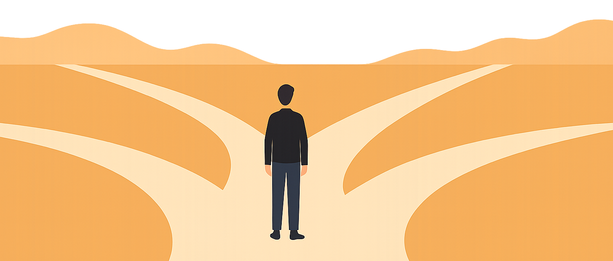
Why apply for funding?
To undertake a research project
To explore / develop new collaboration
To get training

Slide 5





UK funding landscape

Slide 6
Selecting the call
Every scheme is different – want to find the right scheme for what you are trying to do.
Want to start thinking about grant ideas around 3-6 months before you apply to make sure you can put in a competitive application.
Schemes can have quite complex eligibility requirements so make sure you read all the guidance.
You need to check who can apply for the call and make sure you have the necessary collaborators.

Slide 7
Grants
UoB AI for health https://uob.sharepoint.com/sites/elizabeth-blackwell/SitePages/funding.aspx
Royal Society travel grant https://royalsociety.org/grants/international-exchanges/
London Mathematics Society https://www.lms.ac.uk/grants/mathematics-in-africa
NIHR global health themed https://www.nihr.ac.uk/global-health/funding-programmes/ghr-themed
Horizon Europe
Wellcome discovery https://wellcome.org/research-funding/schemes/wellcome-discovery-awards

Slide 8
Application

Slide 9
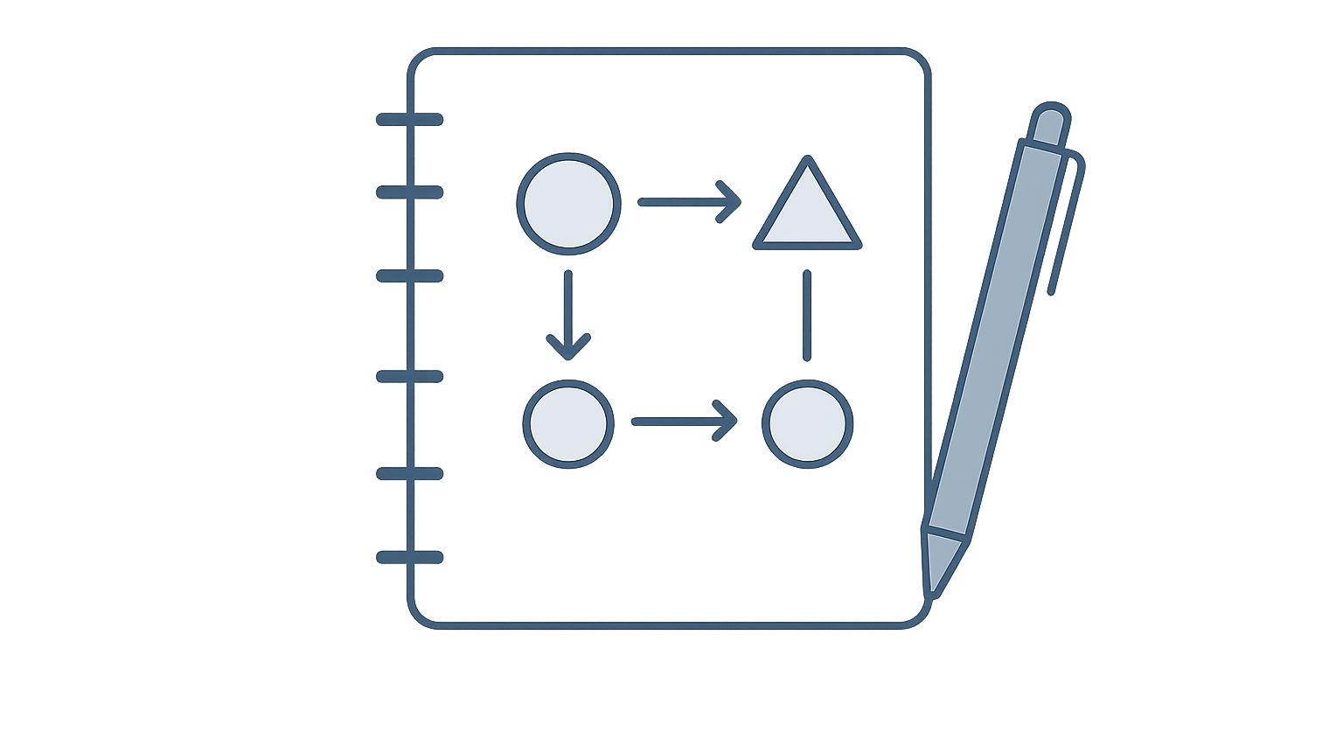
Your science
Your opportunity to communicate your science to the review panel.
How technical it should be, again, depends on the scheme.
How much detail depends a lot on the scheme.
ERC starting grant 19 pages in total about science, some 4 pages
Good to structure your proposal logically.

Slide 10

CV
Two formats now: A traditional one or a narrative CV.
Some like a narrative of how team have worked together / evidence out working together already.
UKRI R4RI modules
Module 1 – Contributions to the generation of new ideas, tools, methodologies or knowledge
Module 2 – The development of others and maintenance of effective working relationships
Module 3 – Contributions to the wider research and innovation community
Module 4 – Contributions to broader research/innovation-users and audiences and towards wider societal benefit

Slide 11
Letters of support
It is helpful to partner with organisations / individuals to support your applications.
Main idea is they write letters of support
Guidance will tell you what sort of support letters they want
UKRI project partners are supposed to give you something.

Slide 12
Mentors / Advisory Board
Give you guidance sometimes technical, sometimes professional development.
Name people but don’t need official support letters.

Slide 13
Data management plan / Research Ethics
We work with human data a lot of the time.
Often have to write data management plans about how we will store / manage data. There are sometimes templates for this.
Often also have to write information about ethics. Don’t always need approval in place already but a plan on how to apply is necessary.
Universities often have teams of people who can help you with this.

Slide 14
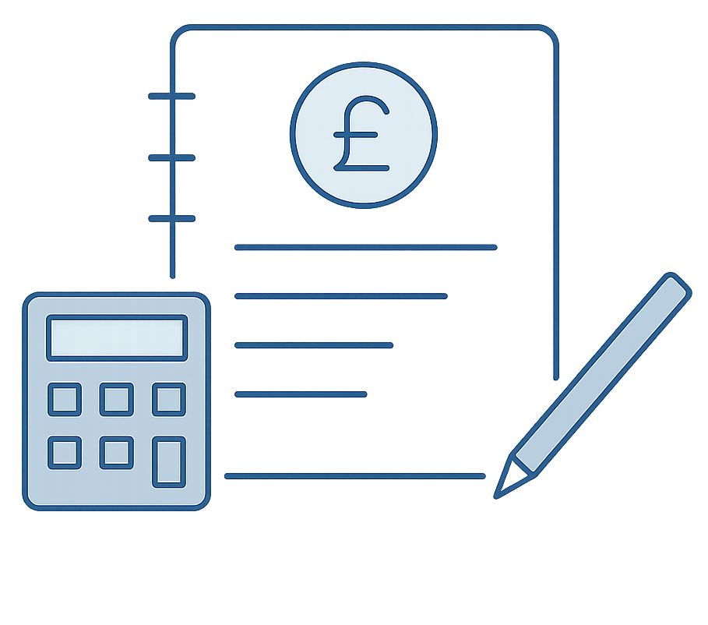
Finance
You will most of the time be expected to submit costings for your application: Staff costs, equipment, travel…
Very clear guidance on what can and can’t be costed.
Usually need external help from someone in your university.
Costs need to be approved.

Slide 15
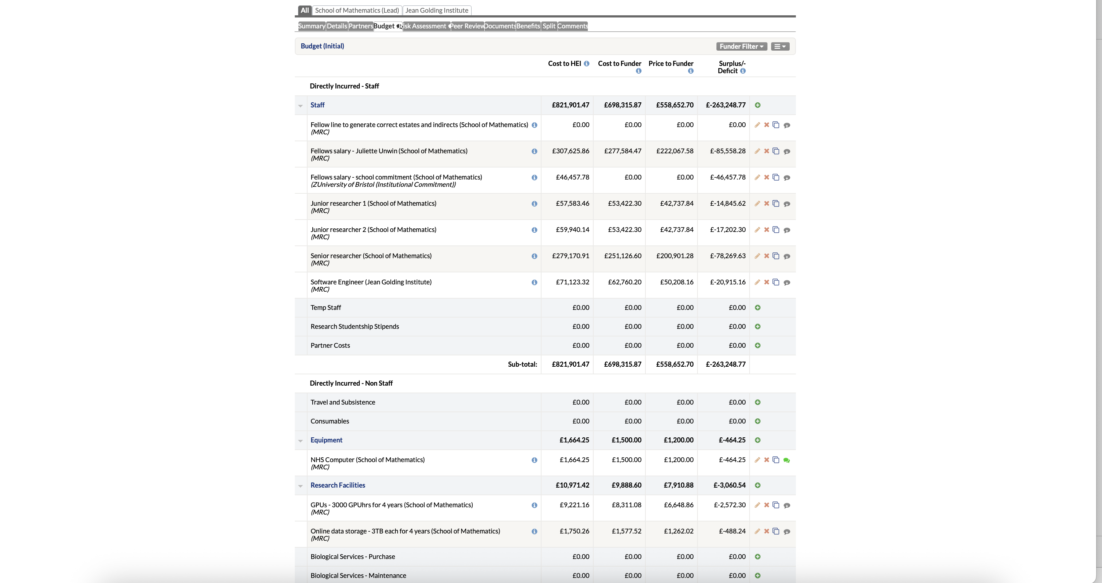
Worktribe

Slide 16
Submission
At universities, you need to submit around a week before the funder deadline so the university / submitting organisation has time to check everything.
Often you press submit and it gets sent to somebody else in the university / submitting organisation to finally submit.

Slide 17
Review process

Slide 18
Reviews
Your review is often sent out to expert reviewers
You can sometimes suggest / ask for some reviewers not to review proposal
Sometimes you get a chance to respond to reviewers
UKRI written response
Wellcome forms part of interview

Slide 19

Interviews
Some grants make final decision based on interview.
Most interviews start with a short presentation – ranged from 3-10 mins.
Some funders give you a list of questions before you are interviewed (UKRI)

Slide 20
Any questions?

